Slide 1
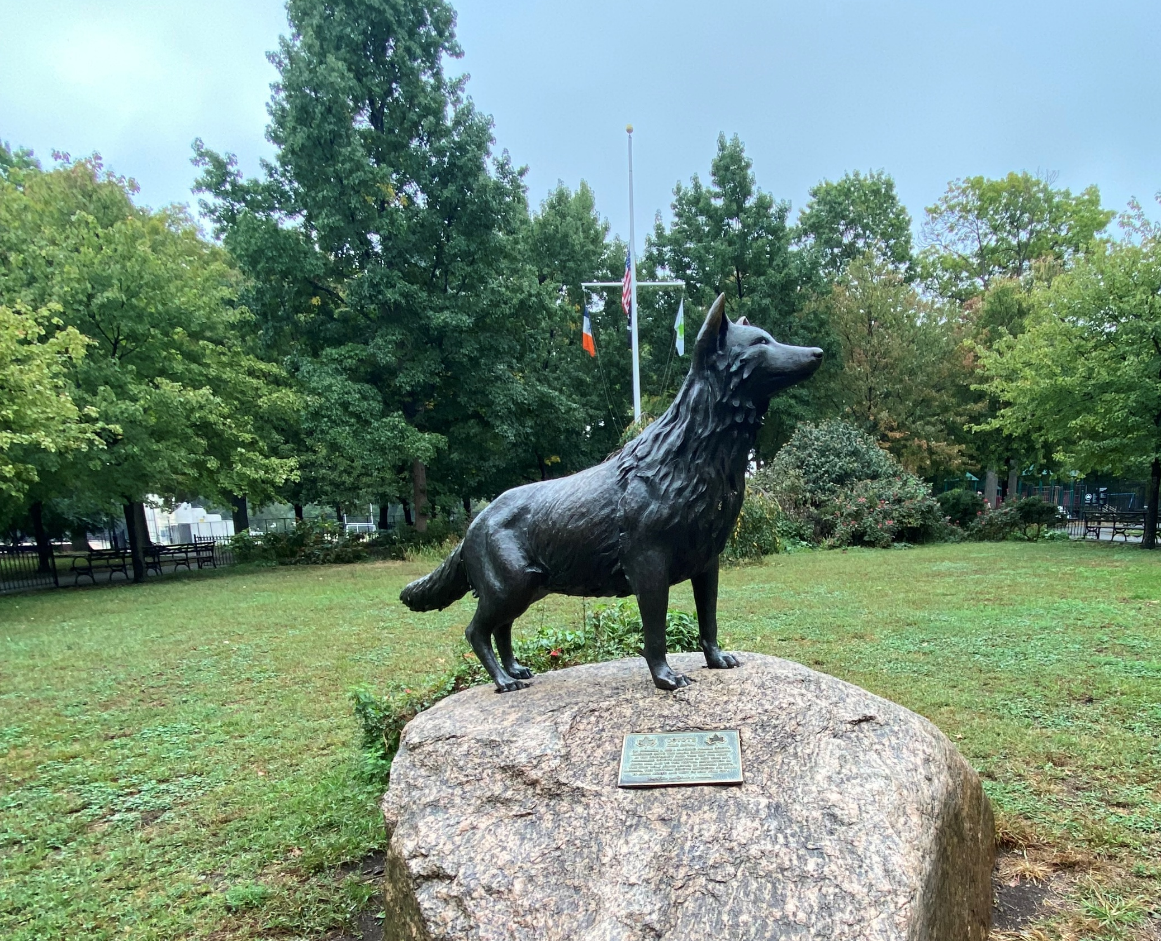
Expansion Across America and Beyond
Canis Latrans
The Adaptable : The Trickster : The Coyote
Van Cortlandt Park coyote statue
Donald Weir NewForce C11 MountWest 2025
Notes:
"Good morning. I'm Donald Weir, and today we're talking about one of North America's most successful colonizers - the coyote. That statue you see is in Van Cortlandt Park in the Bronx – it commemorates the first confirmed urban coyote in New York City, 1946. People were surprised enough to put up a monument. Once restricted to the western plains, coyotes are now everywhere from Alaska to Panama, and they got there by being better at adapting than we were at stopping them."

Slide 2
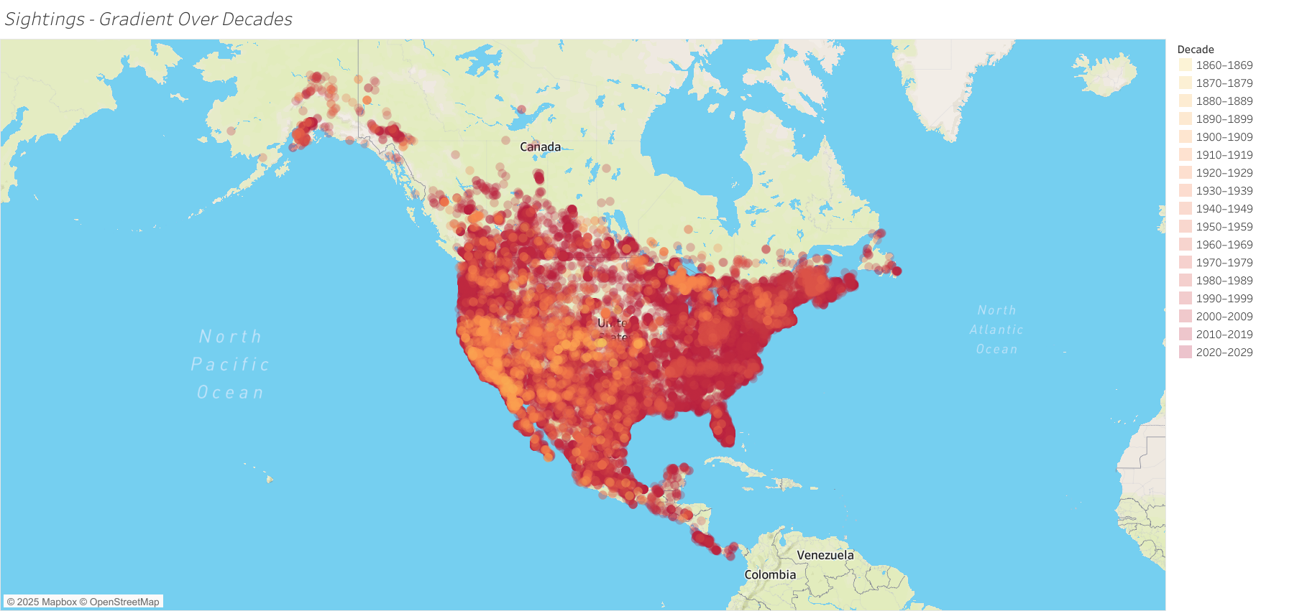
Executive Summary & Guiding Questions
Continental Expansion
Once restricted to the American West, coyotes now span to nearly every ecosystem.
Adaption & Resilience
How do the important periods from 1920 to the present reflect shifts in habitat, monetary impact, and data trends?
How geography, data, and adaptation intersected to redefine this species’ range and relationship with people.
Patterns to Explore
Notes:
"This project tracks two centuries of expansion - how coyotes went from a regional species to a continental one. They've adapted to deserts, forests, farmland, suburbs, and full urban centers. The core questions: Where did they go? What patterns drove that movement? And how do we coexist with something this flexible?"

Slide 3
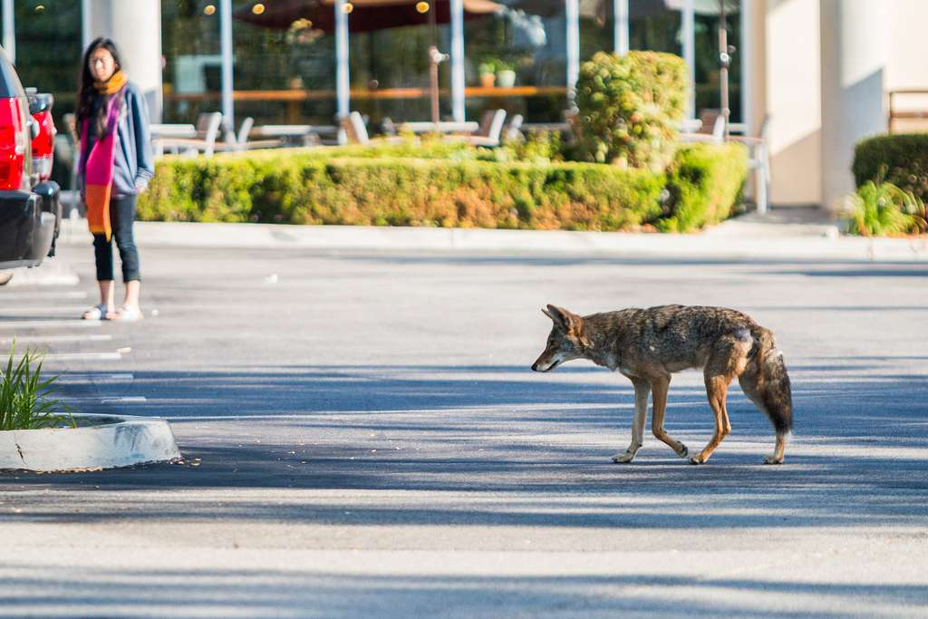
How This Study Was Built
Data Sources & Approach
Study Focus
Wildlife sighting records from government databases and museums (160+ years of data).
USDA reports on livestock losses (2000-2015).
Used Tableau to animate the expansion across time.
Where did coyotes expand and when?
What ecological and human factors enabled this spread?
How do modern data practices reveal patterns invisible in historical records?
Notes:
"Before we jump into the timeline, here's what I analyzed. I pulled wildlife sighting records from government databases and museums - over 160 years of data. I also looked at USDA reports on livestock losses to understand the economic side. The questions were straightforward: Where did coyotes go? When did they get there? And what made it possible? I used Tableau backed with sources to animate the whole timeline so you can actually see the movement unfold."

Slide 4
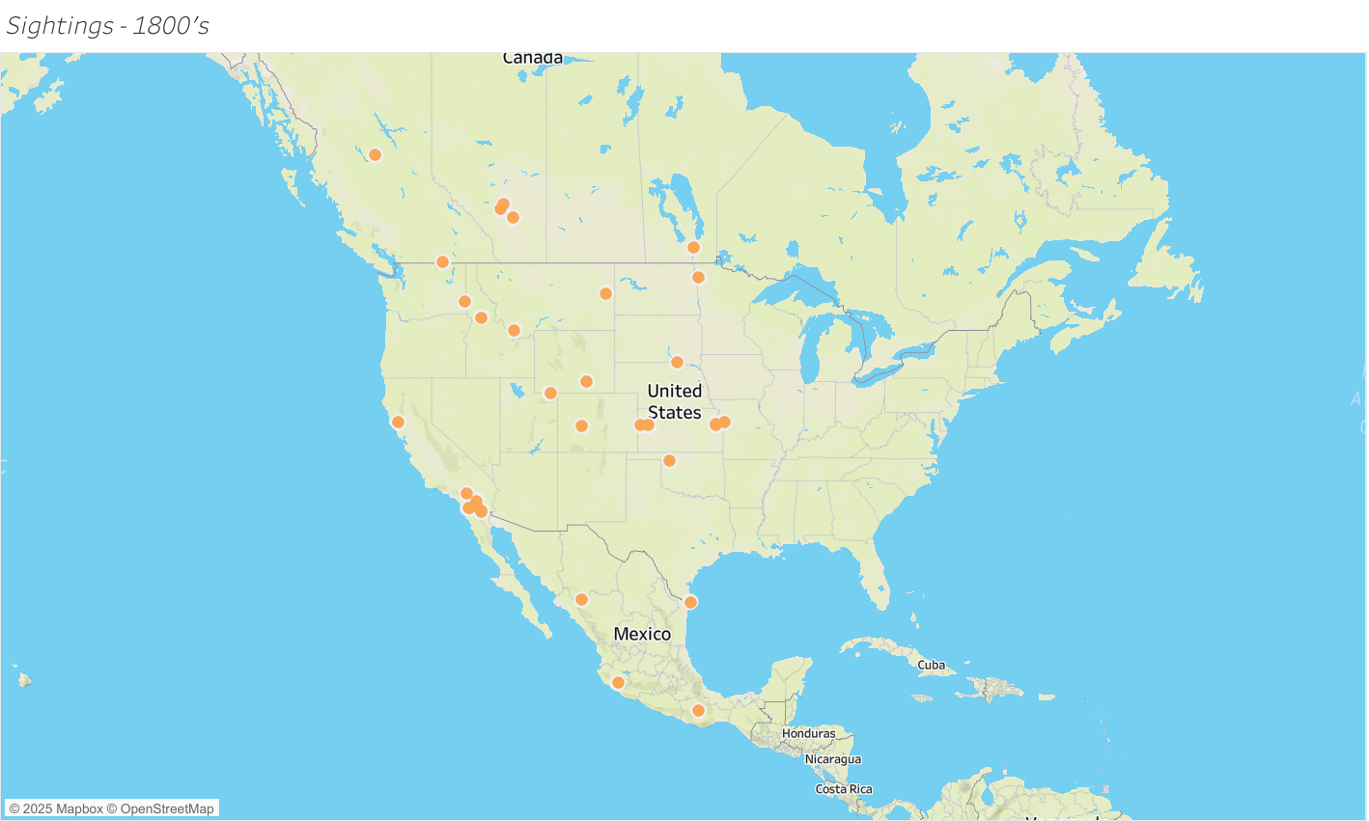
1800s: Origins & Opportunity
Open Home Range
Core populations occupied open plains and western deserts.
Data Type Evolution
Early expansion began quietly across newly altered landscapes.
Notes:
"In the 1800s, coyotes were concentrated in the open plains and western deserts. But as wolves were eradicated and forests were cleared for farming, new corridors appeared. This is where the quiet early expansion starts - long before anyone thought they'd ever leave the West."

Slide 5
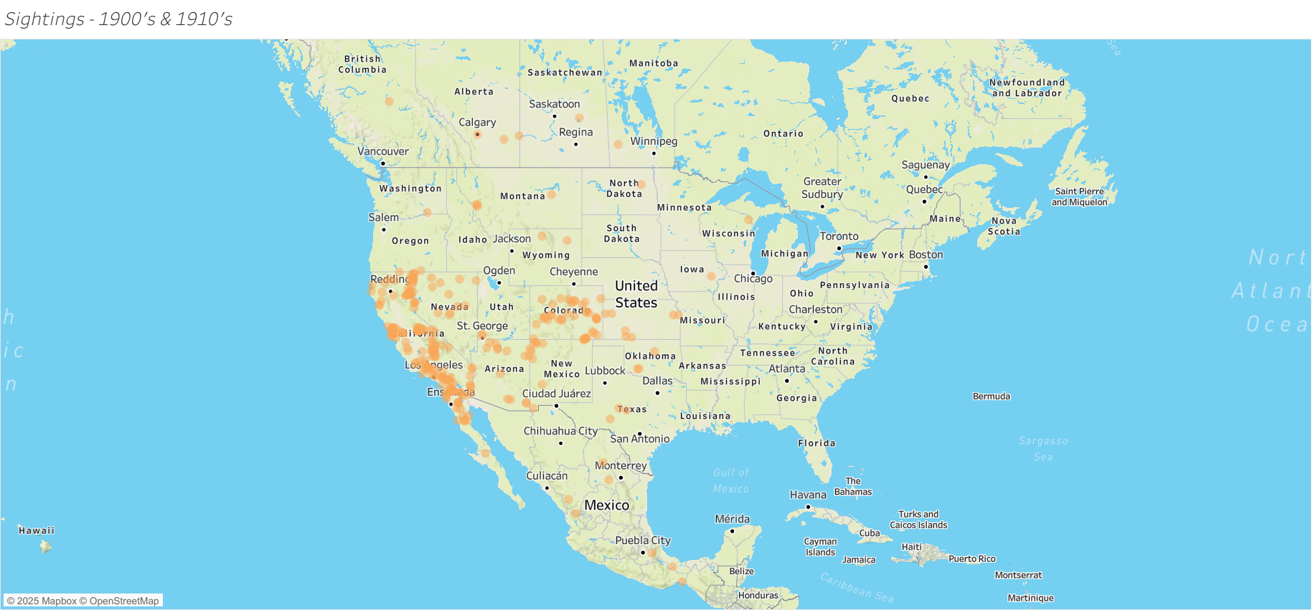
1900s: Crossing the Mississippi
First Eastern Footsteps
Verified east-of-Mississippi sightings mark the species’ first leap forward.
Great Lakes & Beyond
Records emerge in the Great Lakes and southern Canada by mid-century.
Persistence Under Fire
Gradual but persistent growth despite widespread predator control.
Notes:
“By the early 1900s, coyotes crossed the Mississippi — a symbolic line for us, but just another landscape feature for them.
Sightings spread into the Great Lakes and into Canada, even as predator control ramped up.
Their persistence isn’t just stubbornness; it’s the logical outcome of a species that can eat almost anything and live almost anywhere.
They’re not playing by our boundaries. They’re playing by ecological and technological ones.”

Slide 6
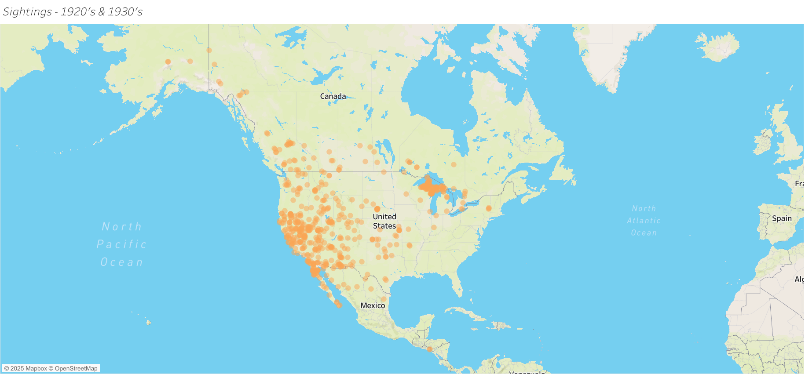
1930s: Consolidation in the West
Western Population Stronghold
Western populations stay strong even under removal programs.
Limited Eastern Presence
Scattered records begin appearing in Appalachia and the Northeast.
Onset of Eastward Expansion
Coyotes expand into flexible generalist predator roles.
Notes:
“In the 1930s, we still see a strong western core, but now with exploratory records beyond Appalachia in the Northeast.
These points don’t yet represent stable populations — rather, it shows a shift in mobility eastward despite mountainous terrain.
Can we live here? Is there food? Is there cover?
The data tells us the answer eventually became yes.”

Slide 7
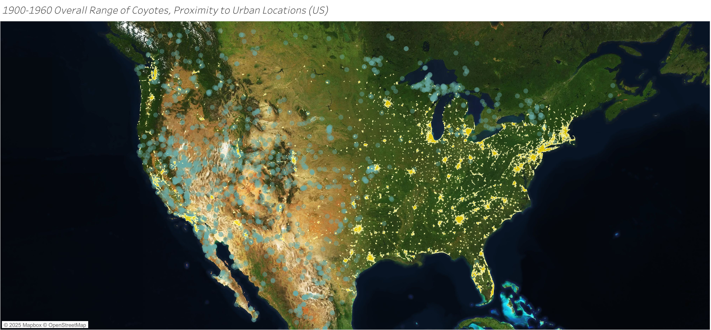
1900–1960: Early Urban Edge Dwellers
Patterns of Early Expansion
Sightings cluster near rail lines, small towns, and early suburbs.
Habitat Opportunism
Behavioral flexibility allows survival within disturbed habitats.
The Urban Pivot
Seeds of modern urban adaptation begin to appear.
Notes:
"From 1900 to 1960, we start seeing coyotes along rail lines, small towns, and early suburbs. They're not 'urban coyotes' yet, but the behavior is there - foraging on edges, using disturbed habitat, getting comfortable near us. You could call this their trial run for city life."

Slide 8
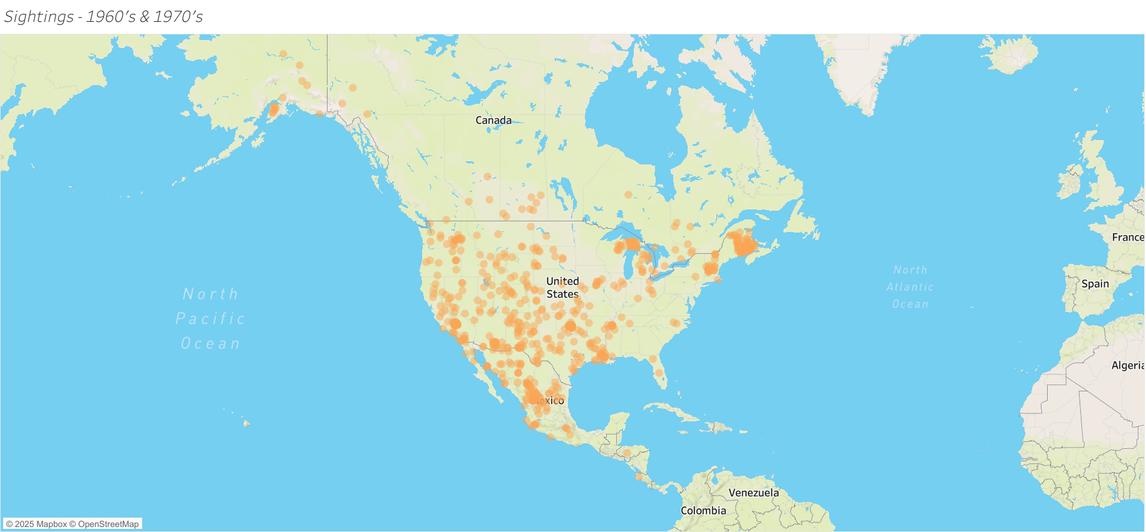
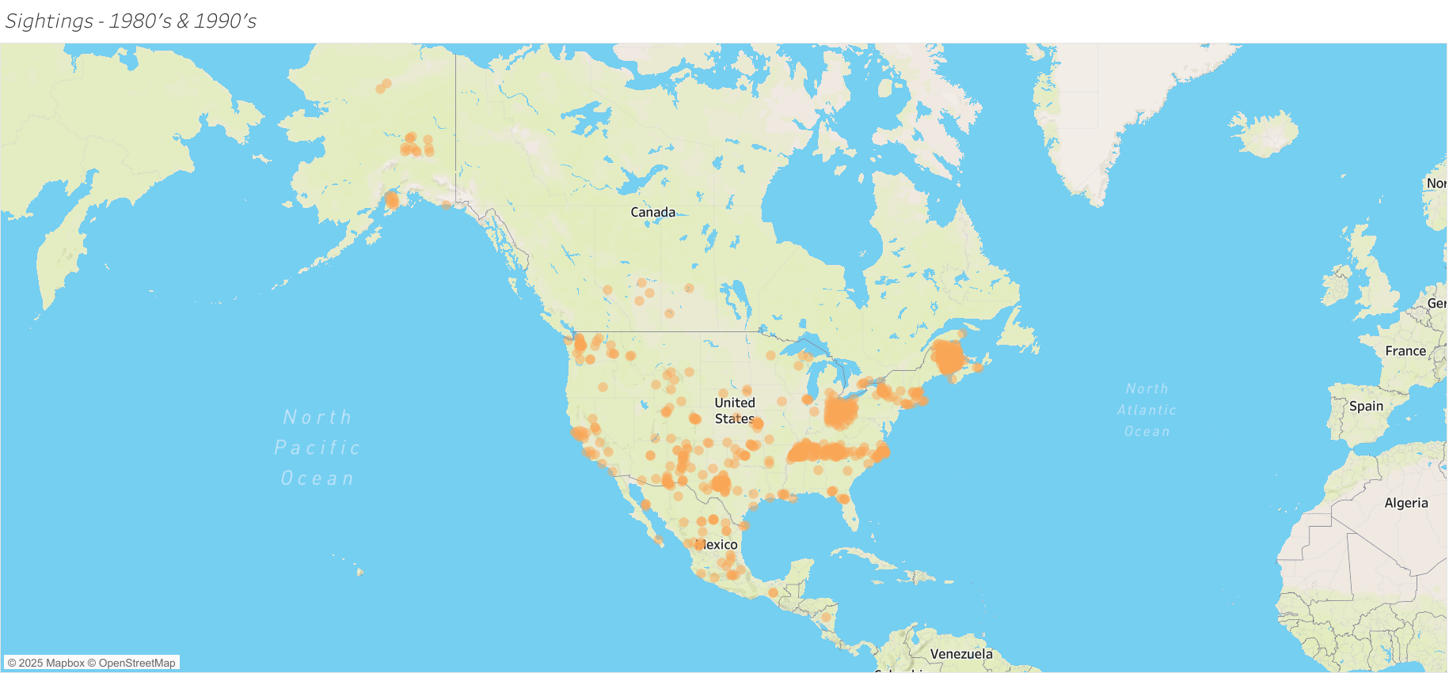
1970s–1990s: The Continental Expanse
Dominant Brush Habitat
Coyotes reach nearly every U.S. biome, from coasts to highlands.
Secondary Habitats
Populations stabilize across the Midwest, Great Lakes, and Northeast.
Ecological Context
Ecosystems rebalance as coyotes replace lost apex predators.
Notes:
"By the 70s through the 90s, the expansion is full force. Coyotes reach nearly every major biome – coasts, deserts, mountains, forests, and definitely farmland. Population stability appears in the Midwest and Northeast, including right here in Appalachia, which shows they're not just passing through - they're establishing."

Slide 9
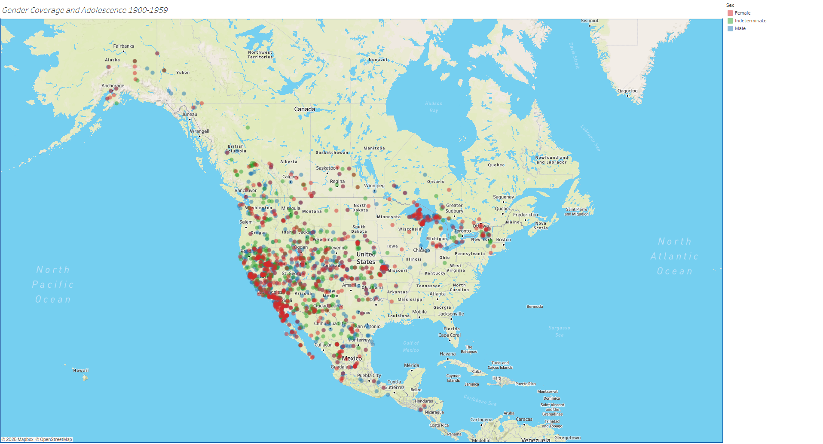
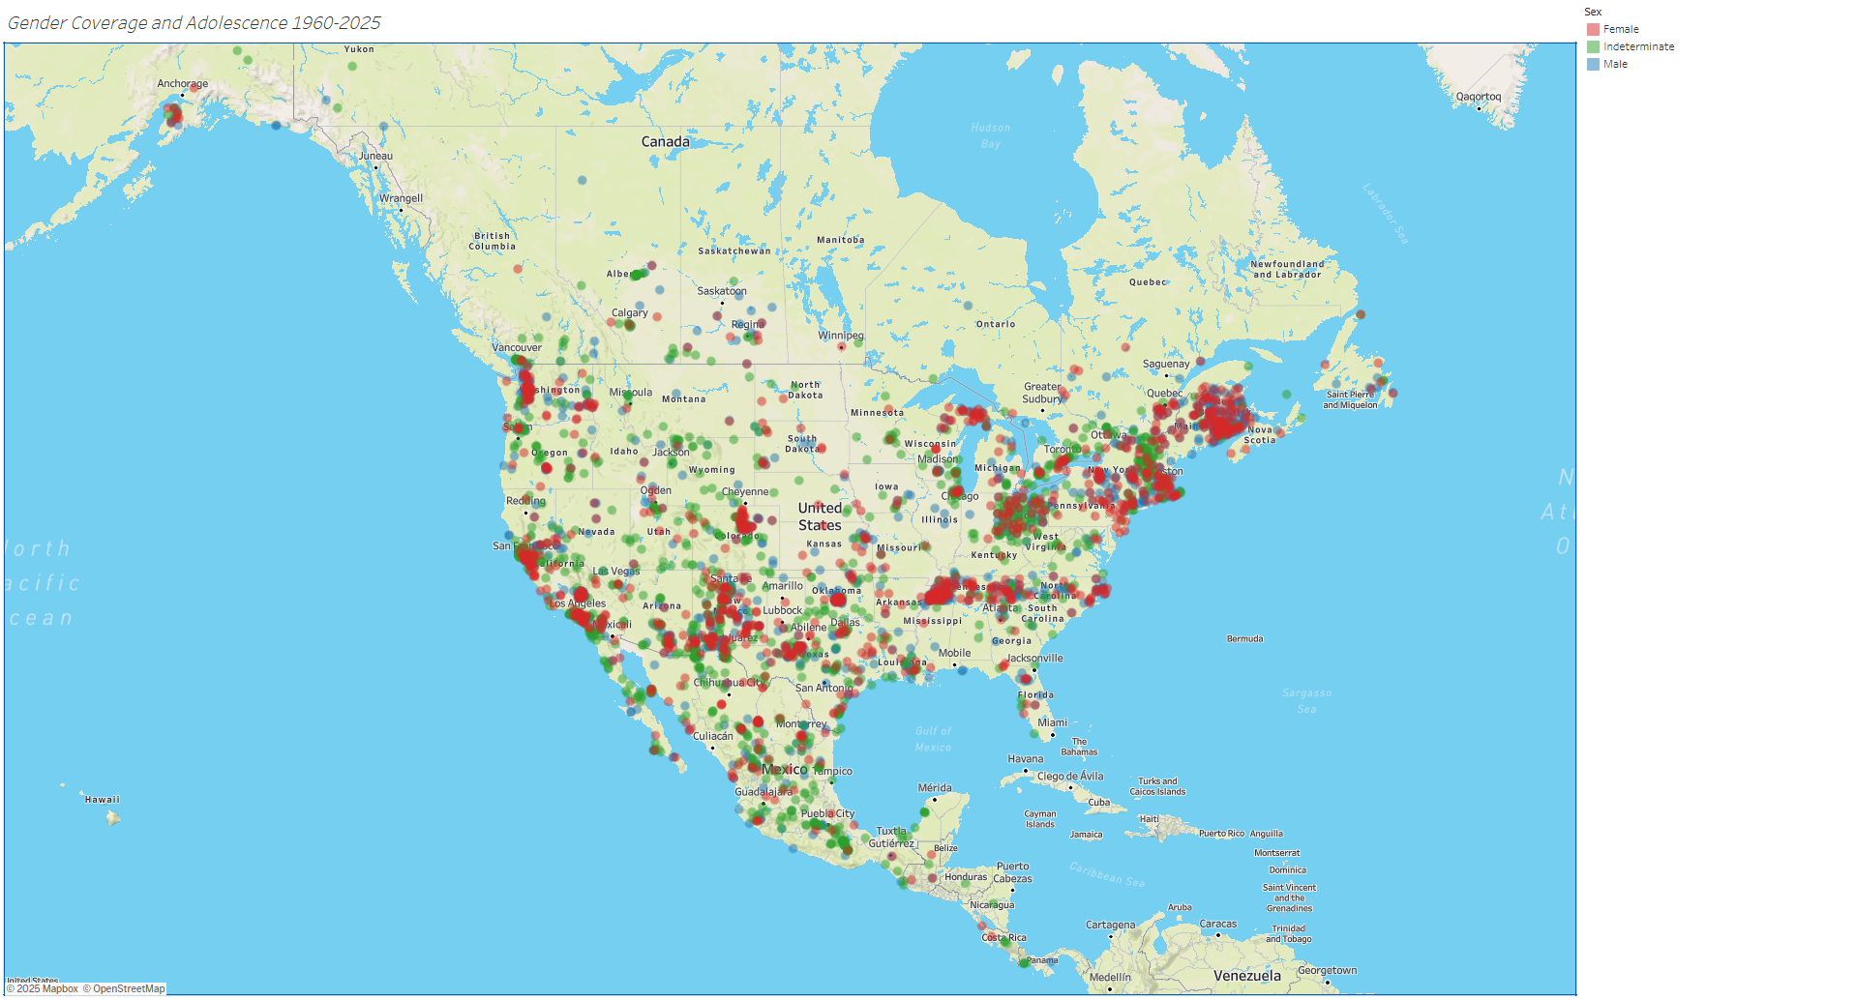
Population Dynamics
Who’s on the Landscape
Age-structure data show adult bias but healthy juvenile recruitment.
Breeding Through Pressure
Indicates ongoing breeding success under diverse conditions.
Resilience in the Numbers
Population stability reflects strong resilience to human pressure.
Notes:
"These two maps show the same data split by time period: early expansion from 1900 to 1959, and modern distribution from 1960 to 2025. Red and blue dots represent adult males and females - these dominate both maps because adults hold territories and are easier to track. Green dots are 'indeterminate' - mostly juveniles and subadults that haven't been sexed yet. They're fewer in number, but their presence across both time periods tells us populations are reproducing successfully, not just made up of wandering individuals. What stands out is the density shift - early records were sparse and western, modern coverage is continental. The population structure stayed consistent even as the range exploded."

Slide 10
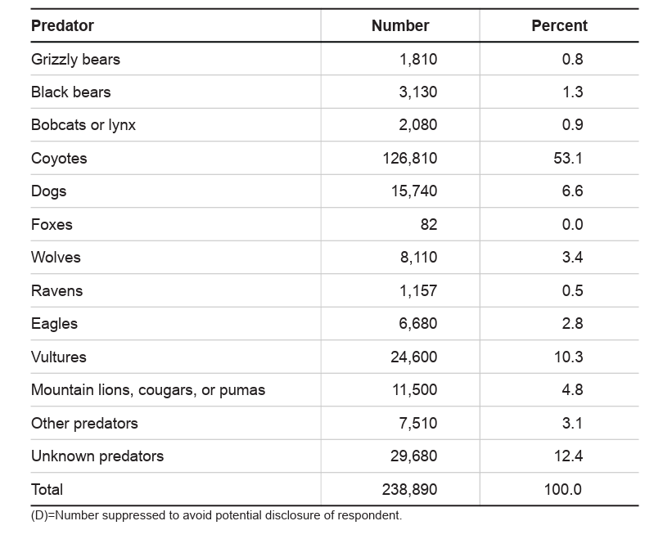
Predator at the Pasture Edge
Top Predator of Concern
Coyotes account for over half of all predator livestock losses.
Most at Risk
Sheep, calves, and goats most vulnerable in open rangelands.
Where Conflict Peaks
Conflict greatest where wildland and ranchland overlap.
https://www.aphis.usda.gov/
Notes:
"From a livestock perspective, coyotes are responsible for over half of predator-related losses. Sheep, calves, and goats are most at risk, especially in open rangelands. Conflict tends to be highest in those overlap zones where farmland meets wild habitat.”

Slide 11
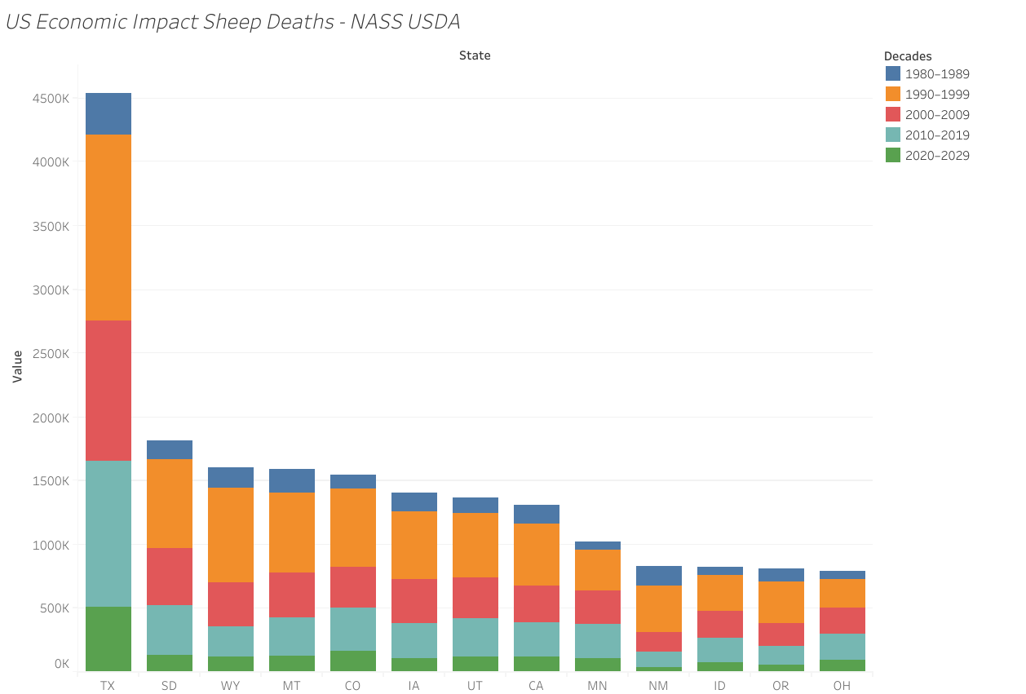
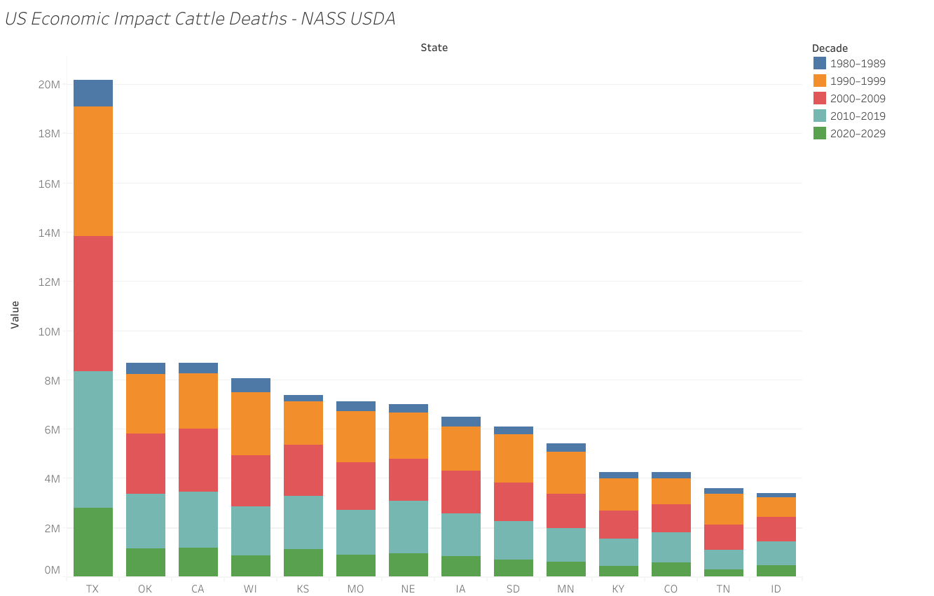
Counting the Cost Over 40 Years
Dollars on the Ground
Annual livestock losses reach tens of millions of dollars nationwide.
Regional Hotspots
Texas, Western and Mountain states sustain the highest regional costs.
Balancing Books and Beings
Highlights need for balanced coexistence and compensation strategies.
Notes:
"These losses add up - tens of millions of dollars nationwide every year. Western states and mountain states take the biggest economic hit because grazing lands are so open. This is where management, compensation, and prevention strategies become necessary."

Slide 12
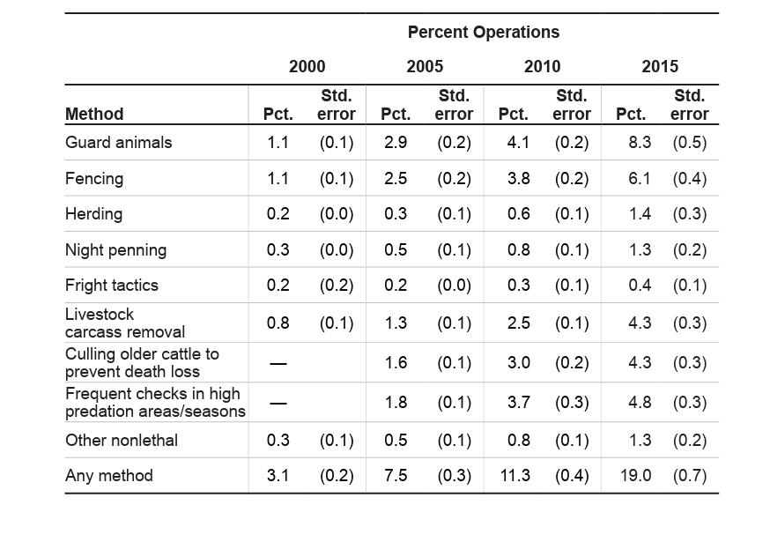
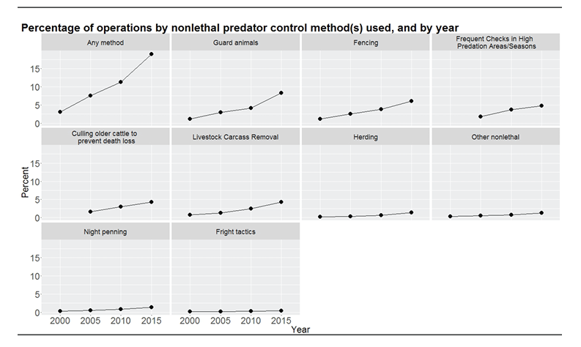
Managing Conflict 2000-2015
Shifting the Toolbox
Non-lethal deterrents increasingly replace older lethal controls.
What Works Where
Guard animals, secure fencing, and lighting gain widespread use.
No One-Size Solution
Results vary by livestock type, terrain, and regional policy.
Notes:
"Most regions now rely on a mix of deterrents: guard animals, fencing, lighting, and behavior-based approaches. Non-lethal tools have grown over the last few decades because lethal control alone doesn't solve long-term conflicts. Different landscapes need different strategies - there's no one-size-fits-all answer.“
*Walkthrough dialogue*
What these charts show are an increase in non-lethal deterrents; such an increase wouldn’t happen if it weren’t monetarily beneficial. -Claude- Make the bulletpoints more representative of the graphics. I don’t want to just assume too much on this slide.
This slide is to represent the trends in non-lethal deterrents, pose the hypothesis of economics, and propose a trend for the future.

Slide 13
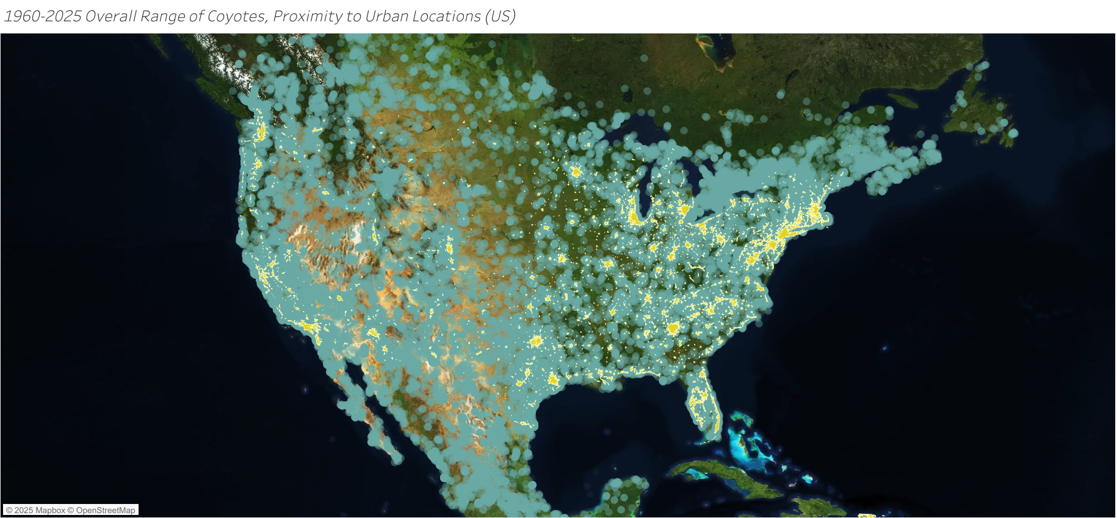
How We Know What We Know
Early Records & Specimens
Early data relied on trappers, naturalists, and museum records.
Survey Era
Late-20th-century surveys and tagging improved regional accuracy.
Real-Time Coyotes
GPS and citizen science now drive real-time wildlife mapping.
Notes:
"Data collection has changed dramatically. Early records came from trappers and museum specimens - very limited. By the 1990s we had structured surveys, and today we have GPS collars, citizen science platforms, and real-time digital reporting. Better data explains why modern maps look so complete compared to historic ones."

Slide 14
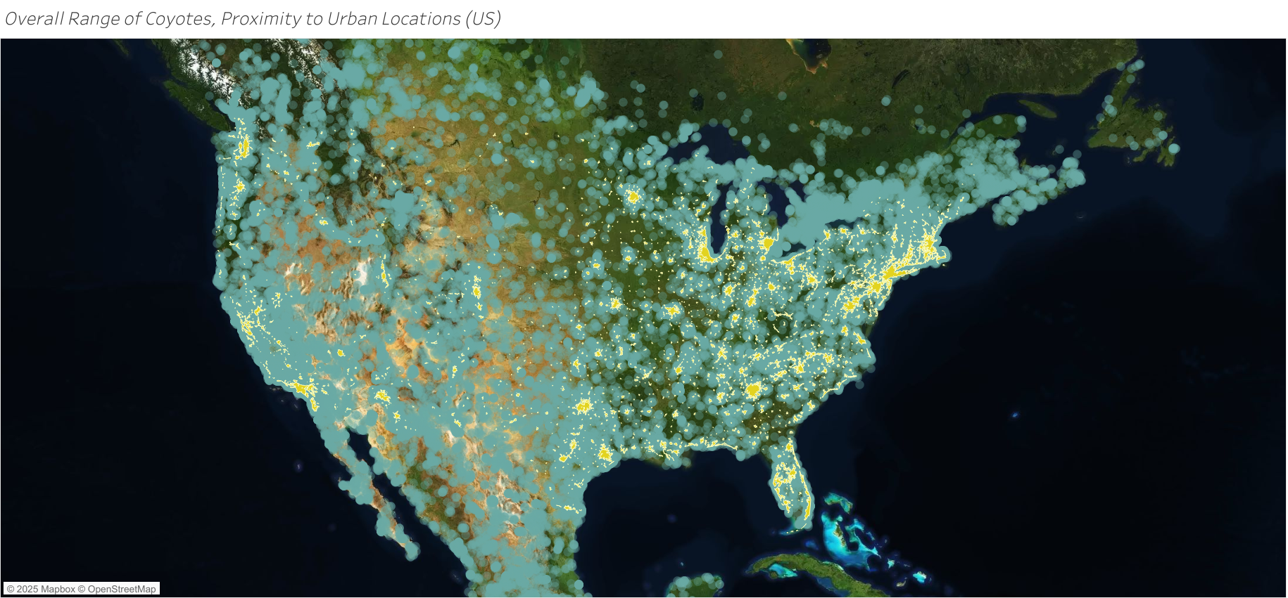
2020s: A Continental Species
Mainland North America
Confirmed in 49 states minus Hawaii and southern Canada.
Moving Southward
Expansion continues south through Central America into Panama, approaching Colombia, a transcontinental leap.
Beyond Any One Biome
Exemplifies adaptability across climates and cultural boundaries.
Notes:
"By the 2020s, coyotes are everywhere - all 49 continental states, Canada, and moving down through Mexico and Central America. What's remarkable is the push into Alaska in the northwest, Canada in the Northeast, and the ongoing expansion south through Panama, potentially approaching South America. This would be a transcontinental predator swap that hasn't happened in the Americas in at least three million years. They thrive everywhere from tundra to tropics, which tells you everything about their adaptability."

Slide 15
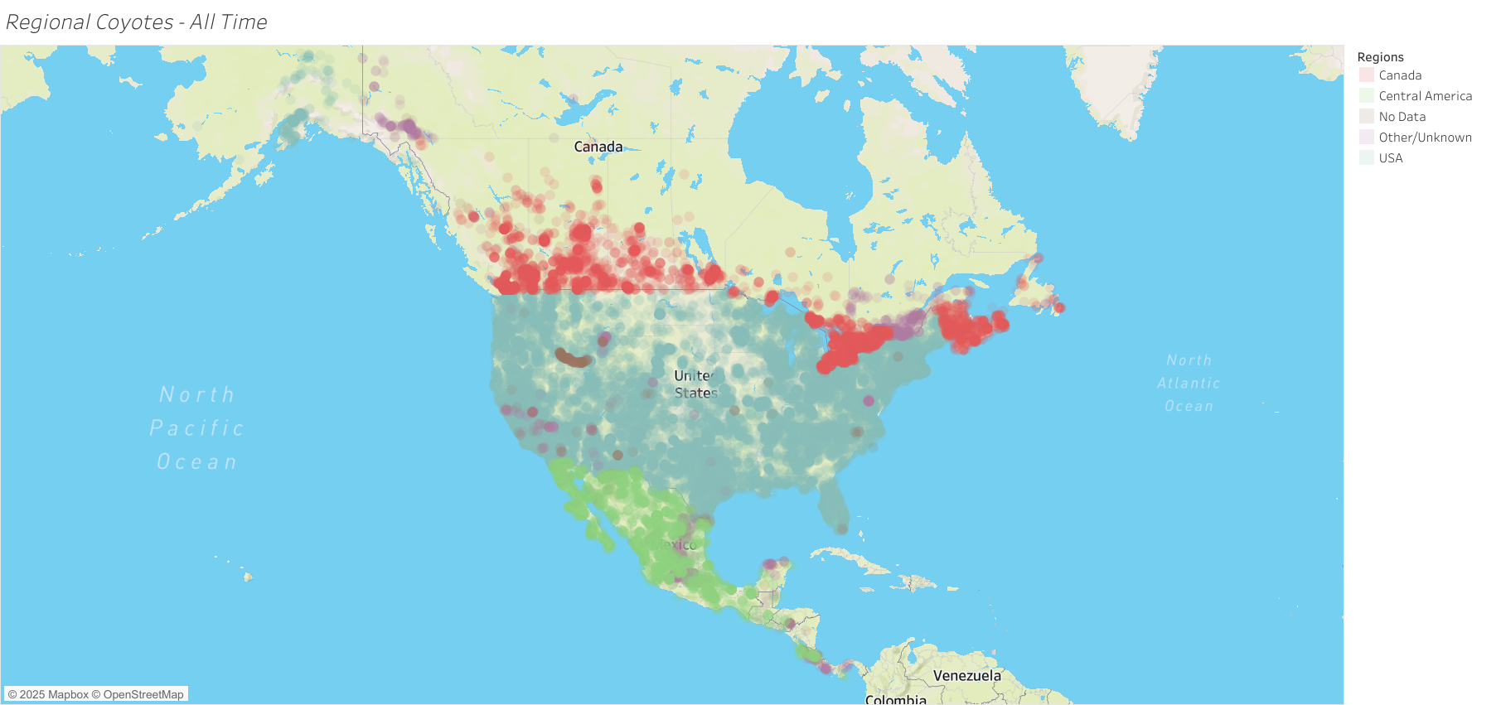
Frontiers & Corridors
New Centers of Density
Densest populations now found in the Northeast and Appalachians.
Active Edges of the Map
Alaska and Panama mark active frontiers of range expansion.
One Connected Spine
Continental corridor links North and Central American ecosystems.
Notes:
"We see dense populations in the Northeast and Appalachian mountains, along with active expansion into Alaska and southern corridors toward Panama and beyond. The northern frontier into Alaska shows coyotes adapting to completely new climates, while the southern movement through Central America could lead to the first contact with South American canids in millions of years. And of course, the eastward push brought them all the way to the Atlantic coast. These patterns show emerging north-south ecological connections we've never seen before at this scale."

Slide 16
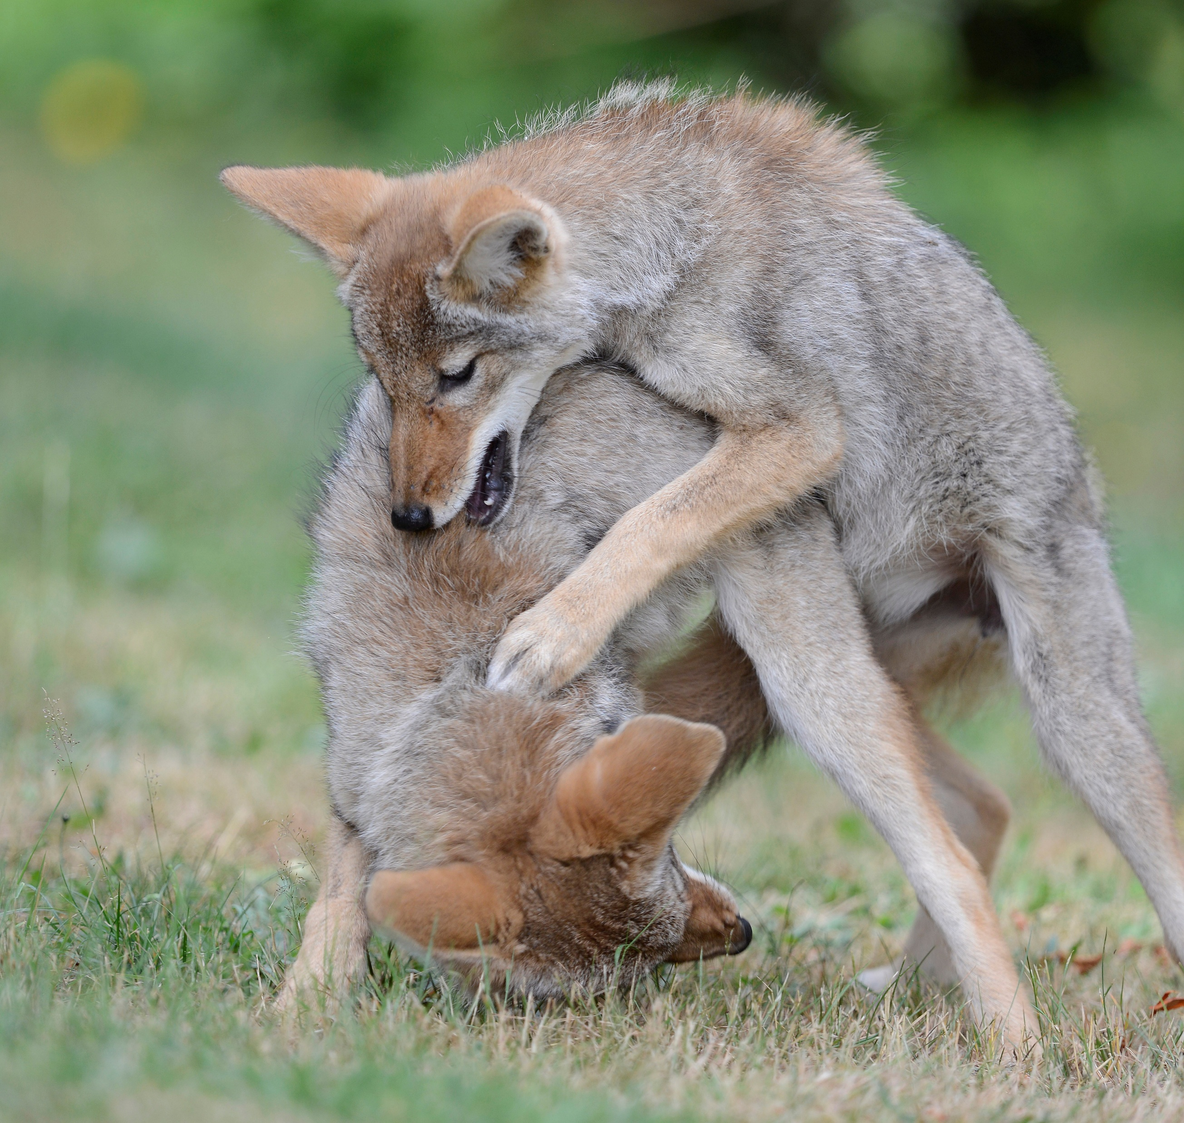
Resilience in Real Time
Watching the Spread
Animated map visualizes two centuries of range growth and impact.
Seeing the Edges Change
Shows spread, urban presence, and changing ecological boundaries.
Coyotes in Our Image
Demonstrates resilience and adaptation in human-shaped landscapes.
Notes:
"This study mapped 160 years of coyote expansion - from western origins to continental coverage including Canada and Central America. The data shows successful adaptation across every major habitat type, including full urban environments. Economically, they're responsible for over half of predator livestock losses, which drove the documented shift toward non-lethal management between 2000 and 2015. And the evolution of data collection itself became part of the story - modern tracking methods revealed expansion patterns that early records completely missed."

